Slide 1



power bi pro.3
View in Power BI
Last data refresh:
8/6/2025 6:32:40 PM UTC
Downloaded at:
8/13/2025 3:54:25 AM UTC

Slide 2
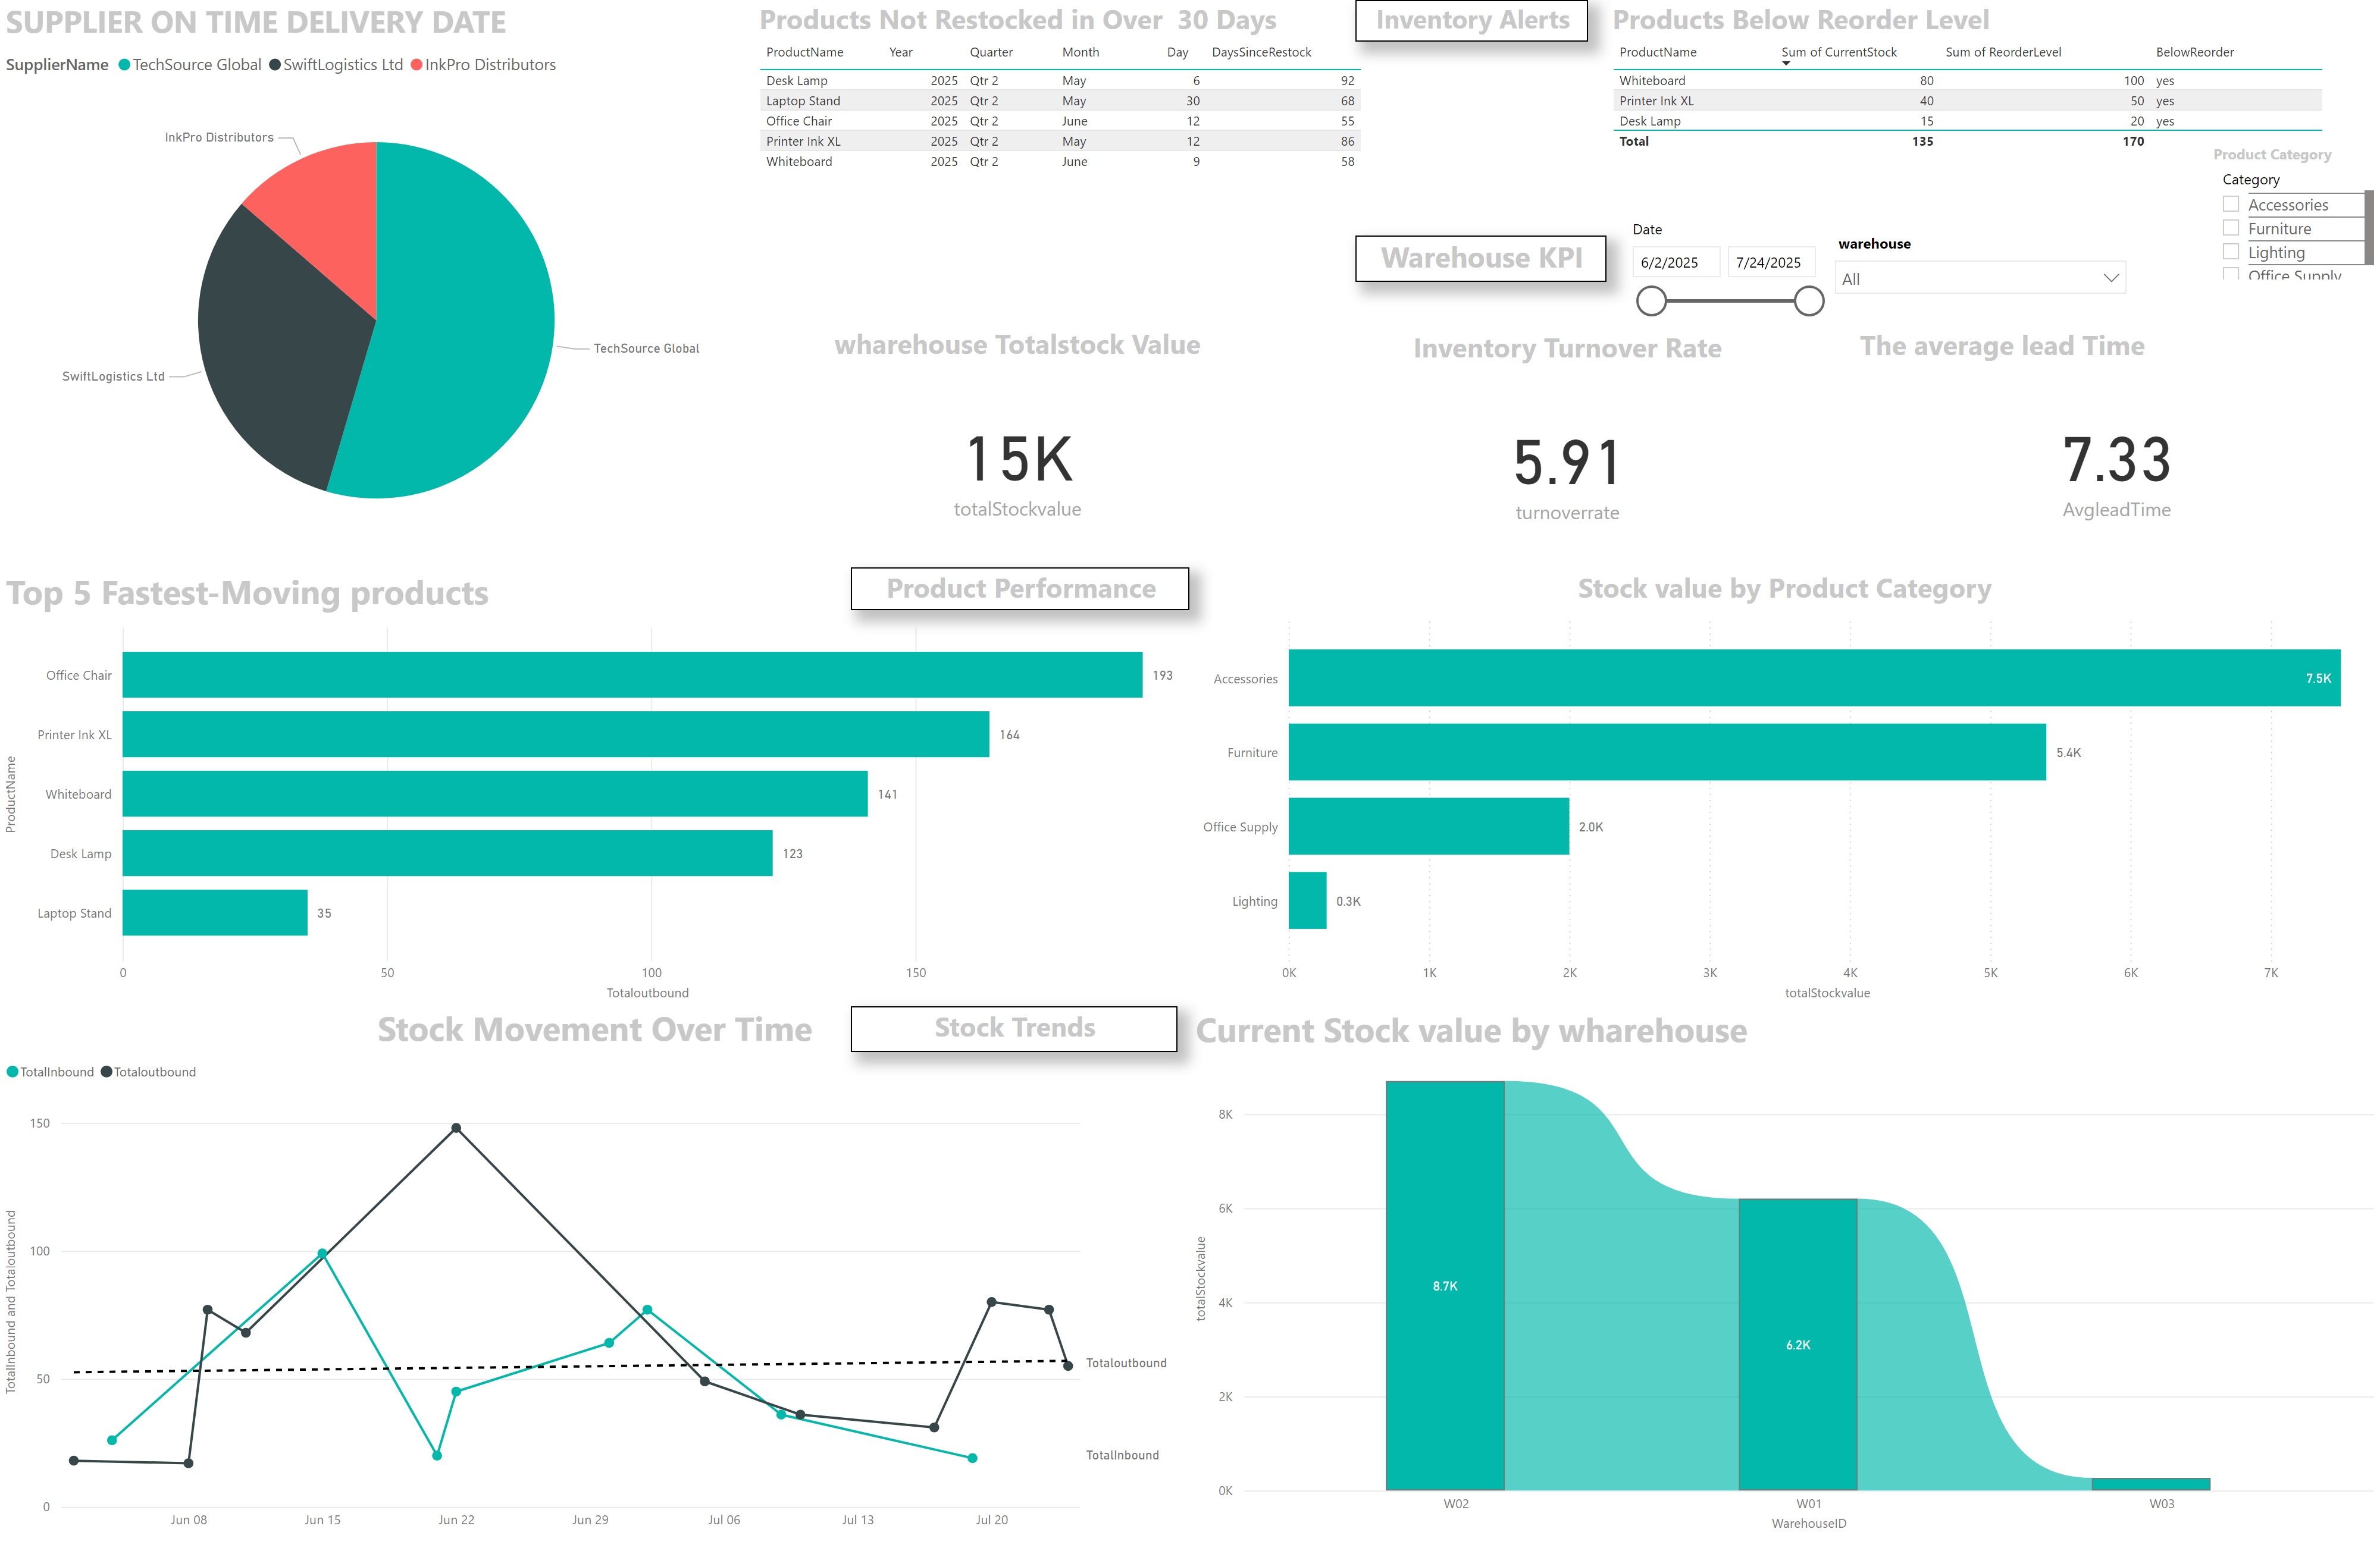
Page 2
Notes:
Product Category
No alt text provided
slicer
No alt text provided
slicer
No alt text provided
wharehouse Totalstock Value
No alt text provided
The average lead Time
No alt text provided
SUPPLIER ON TIME DELIVERY DATE
No alt text provided
Inventory Turnover Rate
No alt text provided
Products Not Restocked in Over 30 Days
No alt text provided
Products Below Reorder Level
No alt text provided
Top 5 Fastest-Moving products
No alt text provided
Stock value by Product Category
No alt text provided
Current Stock value by wharehouse
No alt text provided
Stock Movement Over Time
No alt text provided
Stock Trends
No alt text provided
Product Performance
No alt text provided
Inventory Alerts
No alt text provided
Warehouse KPI
No alt text provided

